Slide 1

CS 3305: Data Structures
Lecture 1: Introduction
Umama Tasnim

Slide 2

Today’s Outline
Administrative Stuff
Overview of the Course
Intro to Data Structures
Notes:
I’m going to try to tell you at the start of each class what I’ll be covering. Here’s today.
Once we get done with some administrative cruft, we’ll get into the exciting stuff.

Slide 3

About Me
Umama Tasnim
MSc. in computer Science, University of Texas at San Antonio
BSc. in Computer Science, University of Dhaka
Research Interest: My interests includes but not limited to machine Learning (ML), Data Science and Human-centered Computing (HCC).
Worked at San Antonio Virtual Reality Lab (SAVE)

Slide 4
Course Information
Instructor: Umama Tasnim
  Email: utasnim@kennesaw.edu
  Office: J-3112 (by appointments only)
  Preferred Communication Method: Email
  GTA:
  Information will upload in the content section

Slide 5
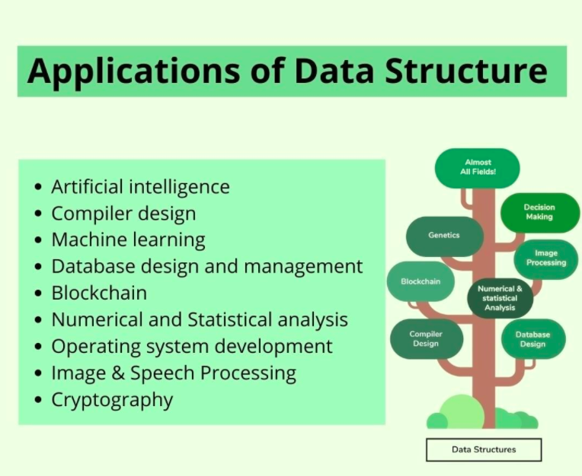

Why Learning Data Structure?
Organizing the data.
It is also used for processing, retrieving, and storing data.

Slide 6
Goals of the Course
Become familiar with some of the fundamental data structures in computer science
Improve ability to solve problems abstractly
  data structures are the building blocks
Improve ability to analyze your algorithms
  Prove correctness
  Gauge (and improve) time complexity
Notes:
This course is designed to familiarize you with the most basic and important data structures in computer science. The ones that will form the foundation of all your future work with computers.
Moreover, you’ll learn how to analyze your programs and data structures so that you know how well they work and what sort of effort in the program is acceptable.
These are the goals of the course as well as my expectations of you.

Slide 7
Observation
All programs manipulate data
  programs process, store, display, gather
  data can be information, numbers, images, sound
Each program must decide how to store data
Choice influences program at every level
  execution speed
  memory requirements
  maintenance (debugging, extending, etc.)
Notes:
Given the importance of data, every program uses it, your knowledge of data structures affects what and how well you can program!
Moreover, it helps you understand what is possible to compute.

Slide 8
What is a Data Structure?
Data Structure - The logical or mathematical model of a particular organization of data is called a data structure.
Some of the more commonly used data structures include lists, arrays, stacks, queues, heaps, trees, and graphs.
A
A
B
C
D
E
F
B
C
Fig 1- Array
D
E
F
Fig 2 - Tree
Notes:
A method of storage which provides through a set of operations functionality to manipulate the data in some useful way.

Slide 9
What is a Data Structure?
Types of Data Structure -
1. Linear Data Structure
Example: Arrays, Linked Lists, Stacks, Queues
2. Nonlinear Data Structure
Example: Trees, Graphs.

Slide 10
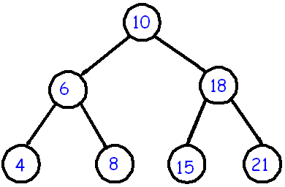
Choice of Data Structures
The choice of data structures depends on two considerations:
It must be rich enough in structure to mirror the actual relationships of data in the real world.
The structure should be simple enough that one can effectively process data when necessary.
10
20
30
40
50
60
70
80
Figure 3: Array with 8 items
Figure 4: Tree with 8 nodes

Slide 11
Data Structure Operations
Traversing: Accessing each record exactly once so that certain items in the record may be processed.
2. Searching: Finding the location of the record with a given key value.
3. Inserting: Adding a new record to the structure.
4. Deleting: Removing a record from the structure.
5. Sorting: Arranging the records in some logical order.
6. Merging: Combing the records in two different sorted files into a single sorted file.

Slide 12
Why so many data structures?
Ideal data structure:
fast, elegant, memory efficient
Generates tensions:
  time vs. space
  performance vs. elegance
  generality vs. simplicity
  one operation’s performance vs. another’s
Notes:
Here’s a simple ADT. The dictionary: like an actual dictionary, it associates some short key piece of information with a longer description of that information. Simple as this interface is, there are at least a dozen data structures, some quite complex, which implement this ADT. Why?
Well, ideally, a data structure is ------------
But not all of these things can necessarily be achieved at once. This creates a set of conflicts which in turn lead us to create many data structures to “solve” any one abstract data type.

Slide 13
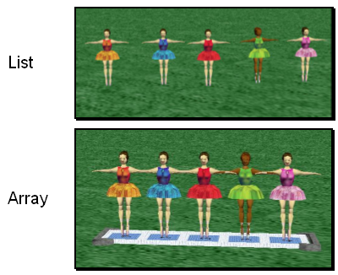
Array
An array is an indexed set of variables, such as dancer_{[1]}, dancer_{[2]}, dancer_{[3]},… It is like a set of boxes that hold things.
A list is a set of items.
An array is a set of
variables that each
store an item.

Slide 14
Lists
A list is an ordered set of data. It is often used to store objects that are to be processed sequentially.
A list can be used
to create a queue.

Slide 15
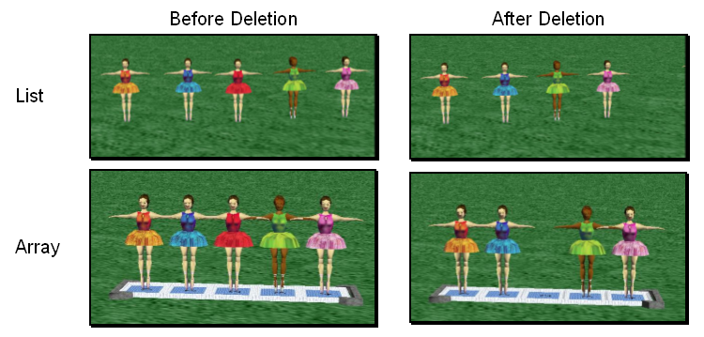
Array and Lists
You can see the difference between arrays and lists when you delete items.

Slide 16
Array and Lists
In an array, an empty variable is left behind when something is deleted.

Slide 17
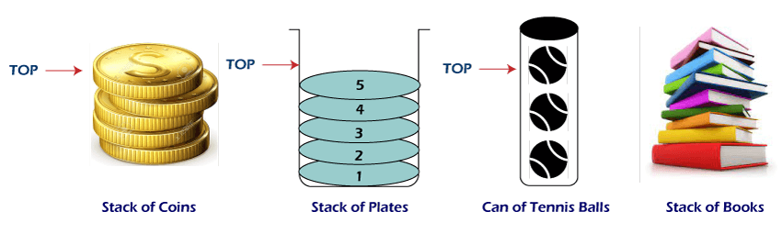
Stack
LIFO (Last in First Out)
Converting infix to postfix expressions.
Undo/Redo button/operation in word processors.

Slide 18

Queue
FIFO (First in First Out)
Fast and optimized.
Operating systems, network protocols, and data processing systems.

Slide 19
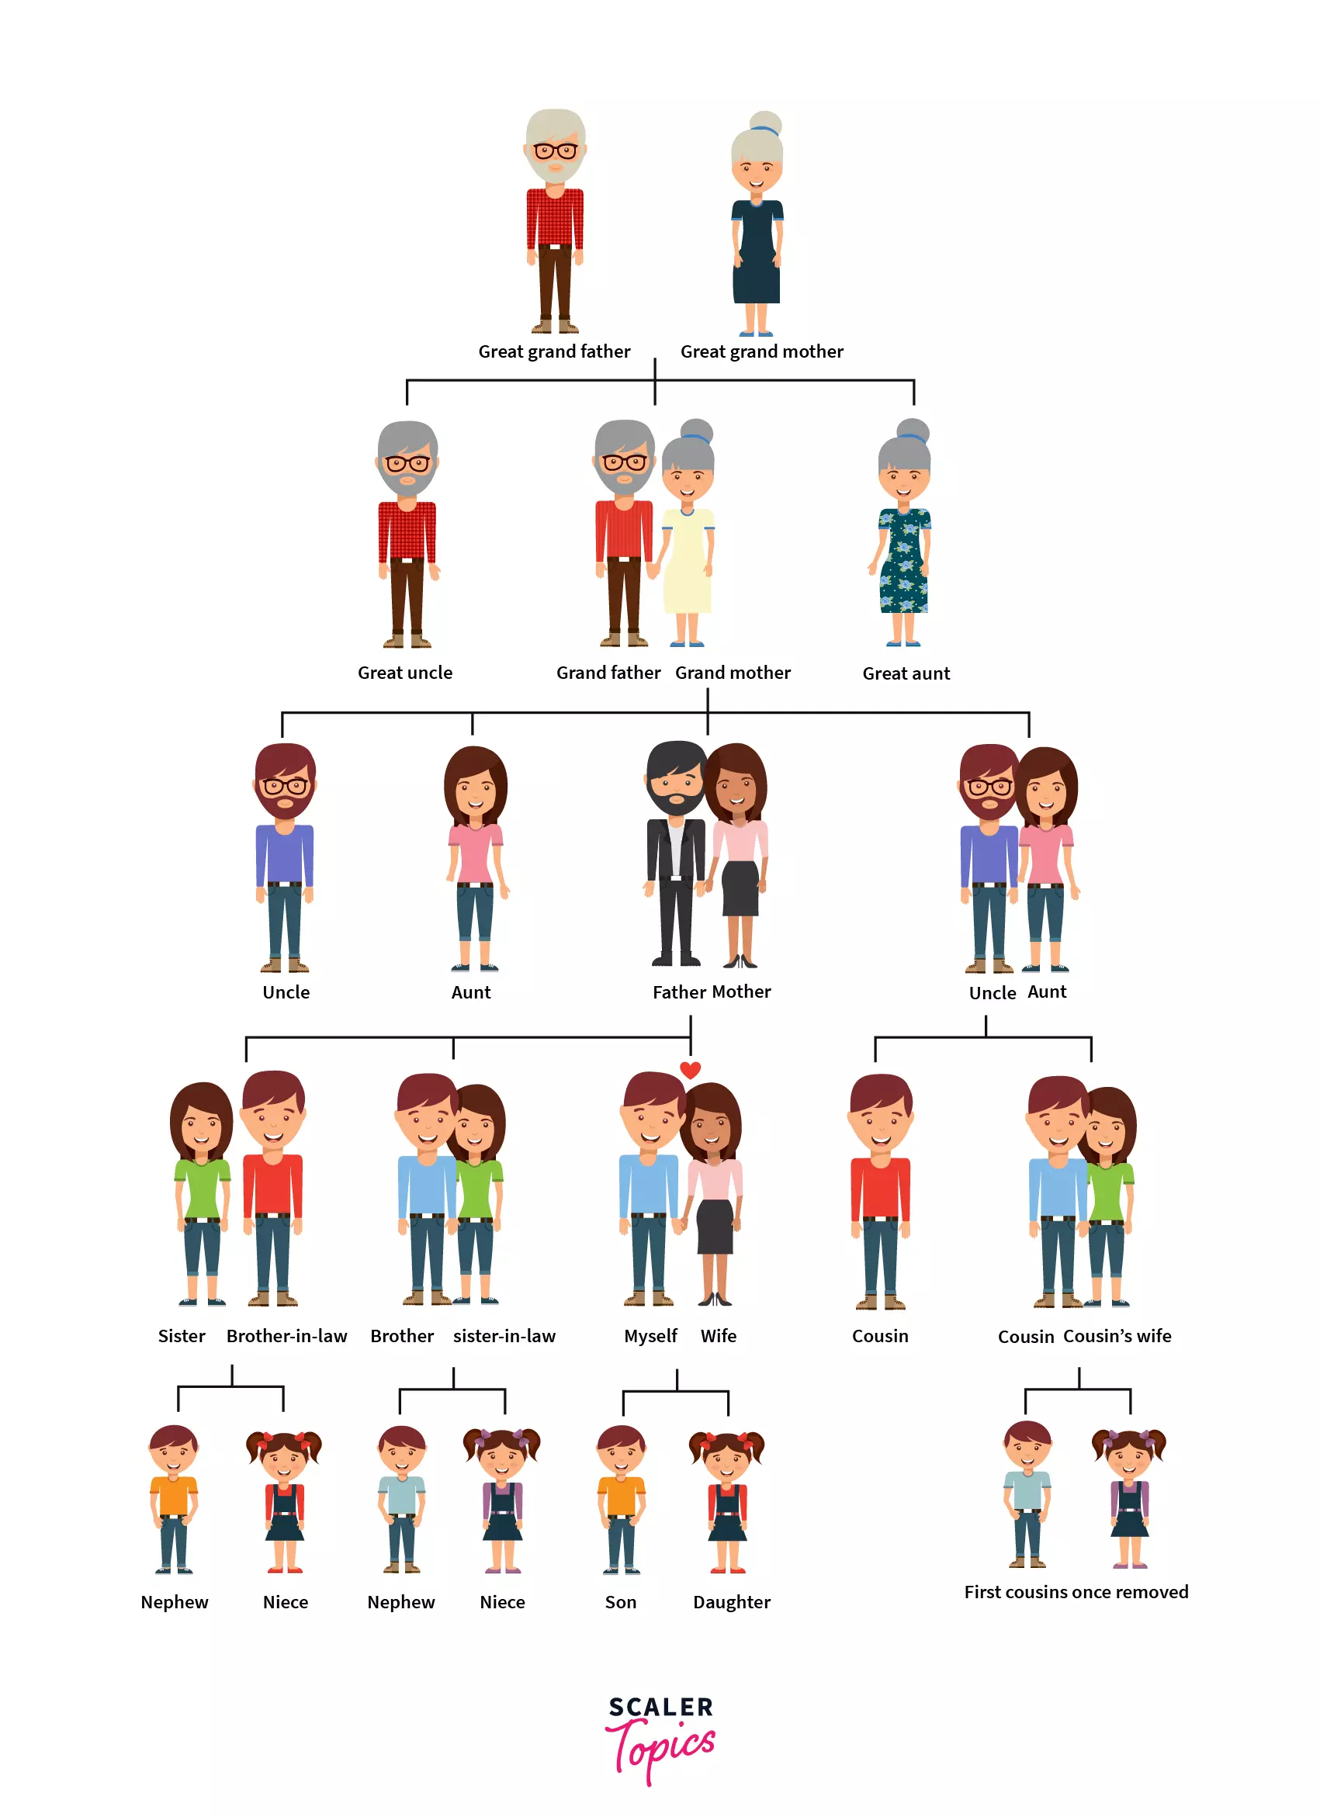
Tree
The tree is a nonlinear hierarchical data structure and comprises a collection of entities known as nodes.
In a file system, directories, or folders, are structured as a tree.
Easy to understand and visualize the data

Slide 20
Algorithm
It is a well-defined set of instructions used to solve a particular problem.
Example:
Write an algorithm for finding the location of the largest element of an
array Data.
Largest-Item (Data, N, Loc)
1. set k:=1, Loc:=1 and Max:=Data[1]
2. while k<=N repeat steps 3, 4
3. If Max < Data[k] then Set Loc:=k and Max:=Data[k]
4. Set k:=k+1
5. write: Max and Loc
6. exit

Slide 21
Complexity of Algorithms
The complexity of an algorithm M is the function f(n) which gives the running time and/or storage space requirement of the algorithm in terms of the size n of the input data.
Two types of complexity
1. Time Complexity
2. Space Complexity

Slide 22
Asymptotic Notation
These notations are used to describe the running time or space requirement of an algorithm.
1. 0-notation
2. Ω-notation
3. Θ-notation
4. o-notation
5. ω-notation

Slide 23
Upcoming topics
Briefly describes Recursion, Array and Link Lists
Coding Examples

Slide 24

Thank you

